Slide 1
449 Profiler Software Overview
Charlie Martin
449 Profiler Design Review
June 9, 2010
NCAR

Slide 2
Requirements
I/F digitization and down conversion
Coherent integration
Complimentary pair pulse coding/decoding
Baseband data acquisition
System timing
Pulse generation
Data distribution
Real-time product generation
Archiving
Visualization
System Control

Slide 3
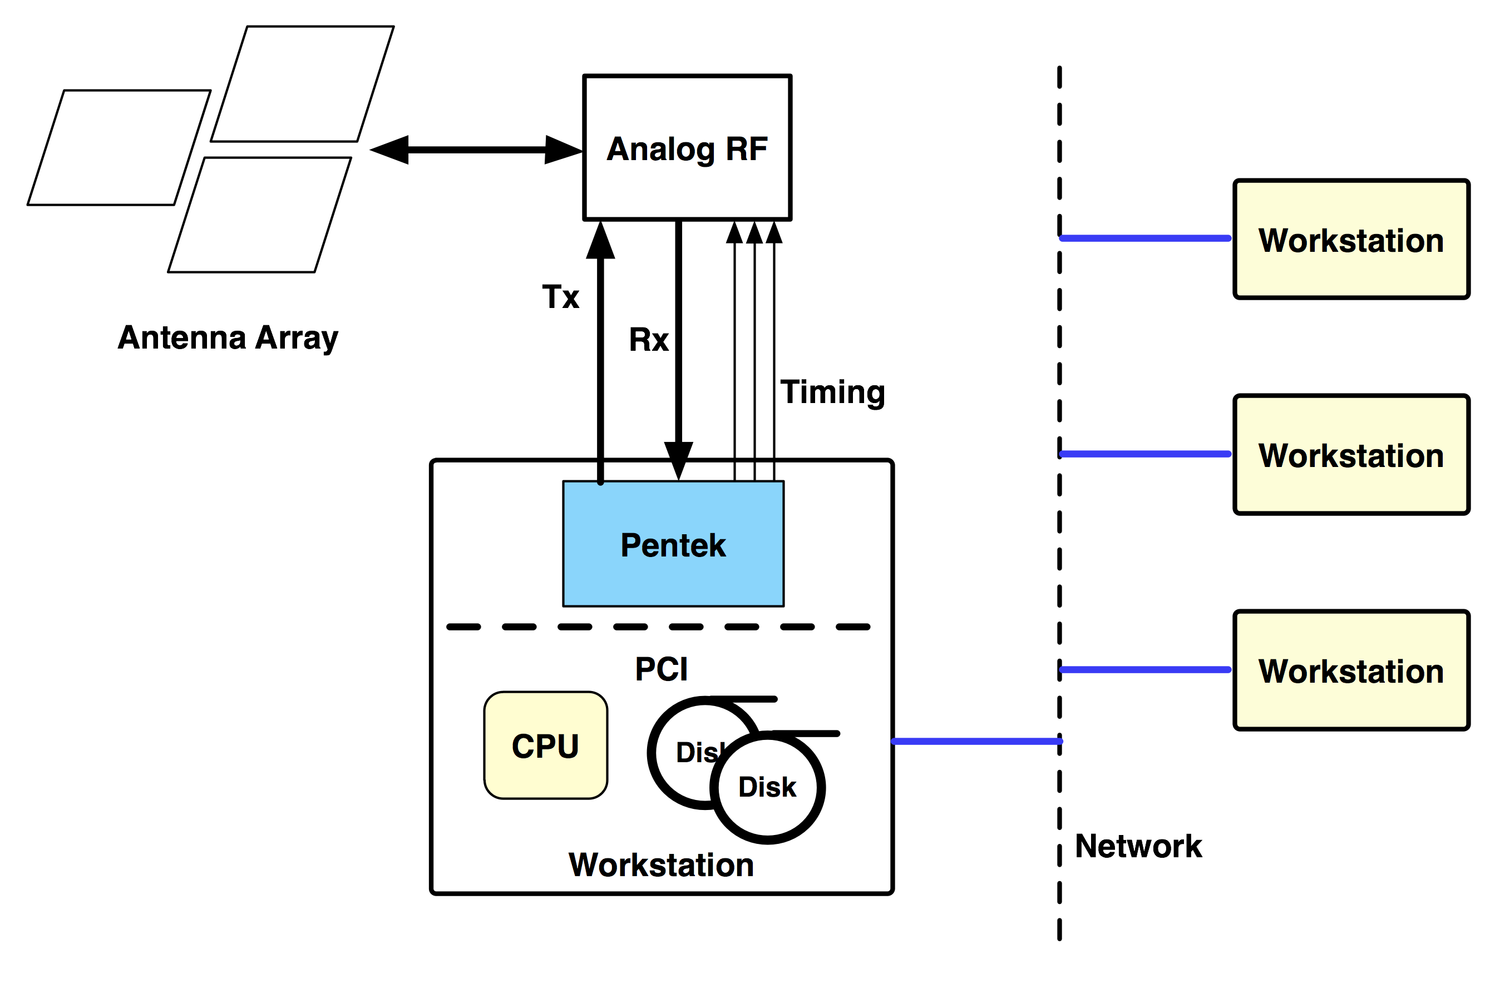
Hardware Environment

Slide 4
Software Technologies
VHDL
Matlab
Linux
C⁺⁺
OpenDDS
Qt
XML RPC

Slide 5
Development Support
Xilinx Integrated Software Environment (ISE)
Eclipse
Qt Designer
Subversion
Scons

Slide 6
Shared Resources
SD³C: Software Defined Digital Down Converter
  449 Profiler, HIAPER Cloud Radar, WARDS*, Ka Band*
EOL DDS: Class library for data distribution
EOL Site Scons: Build utilities
Qt Toolbox: Visualization components

Slide 7
Pentek 7142

Slide 8
SD³C Firmware Hierarchy

Slide 9
Example Firmware

Slide 10
FPGA Timing

Slide 11
SD³C Block Diagram

Slide 12
Data Distribution Services
DDS: Object Management Group (OMG) standard
Publish/subscribe middleware for distributed systems
Data type aware
High bandwidth and low latency
Configurable QOS

Slide 13
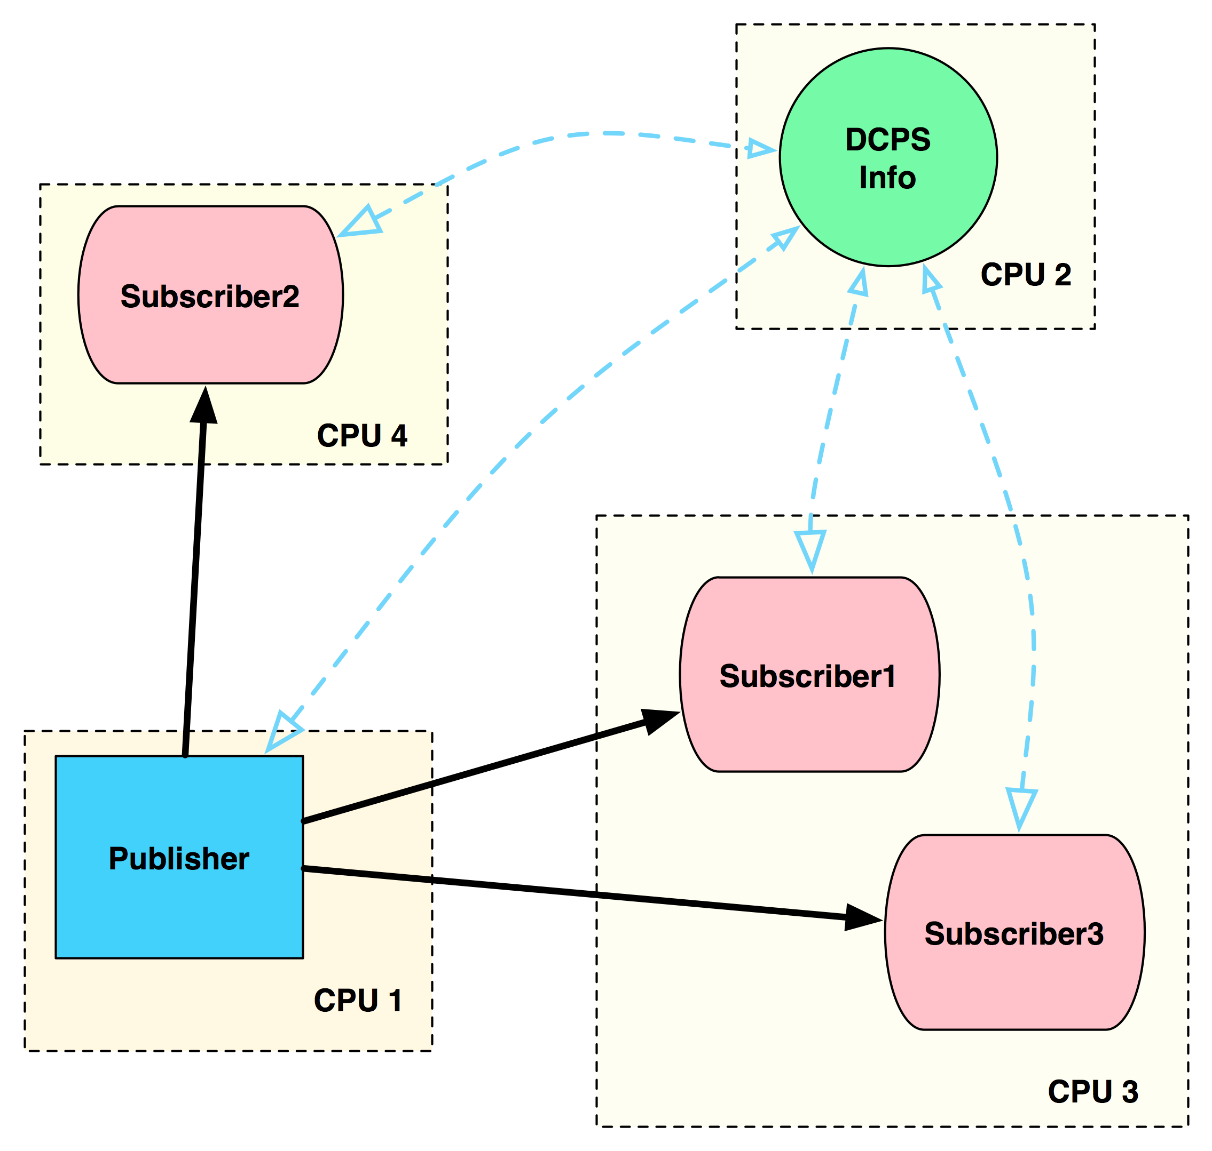
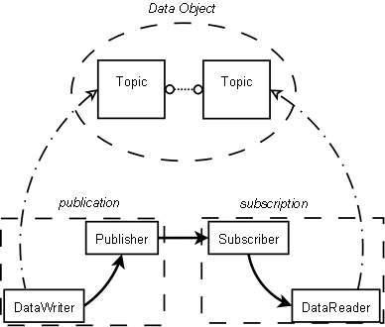
DDS Basics
Topics, publishers and subscribers
Processes

Slide 14
DDS Interface Definition Language
module ProfilerDDS {
/// TSData carries I and Q pairs for a number of consecutive gates
typedef sequence<short> TSData;
/// Housekeeping for time series data
typedef struct ts_housekeeping_ {
long long timetag; /// microseconds since 1 Jan 1970 00:00:00 UTC
long gates;
} TSHousekeeping;
/// TimeSeries carries housekeeping and I and Q pairs for a number of
/// consecutive gates for one channel and one transmit pulse.
typedef struct time_series_ {
TSHousekeeping hskp;
TSData data;
} TimeSeries;

Slide 15
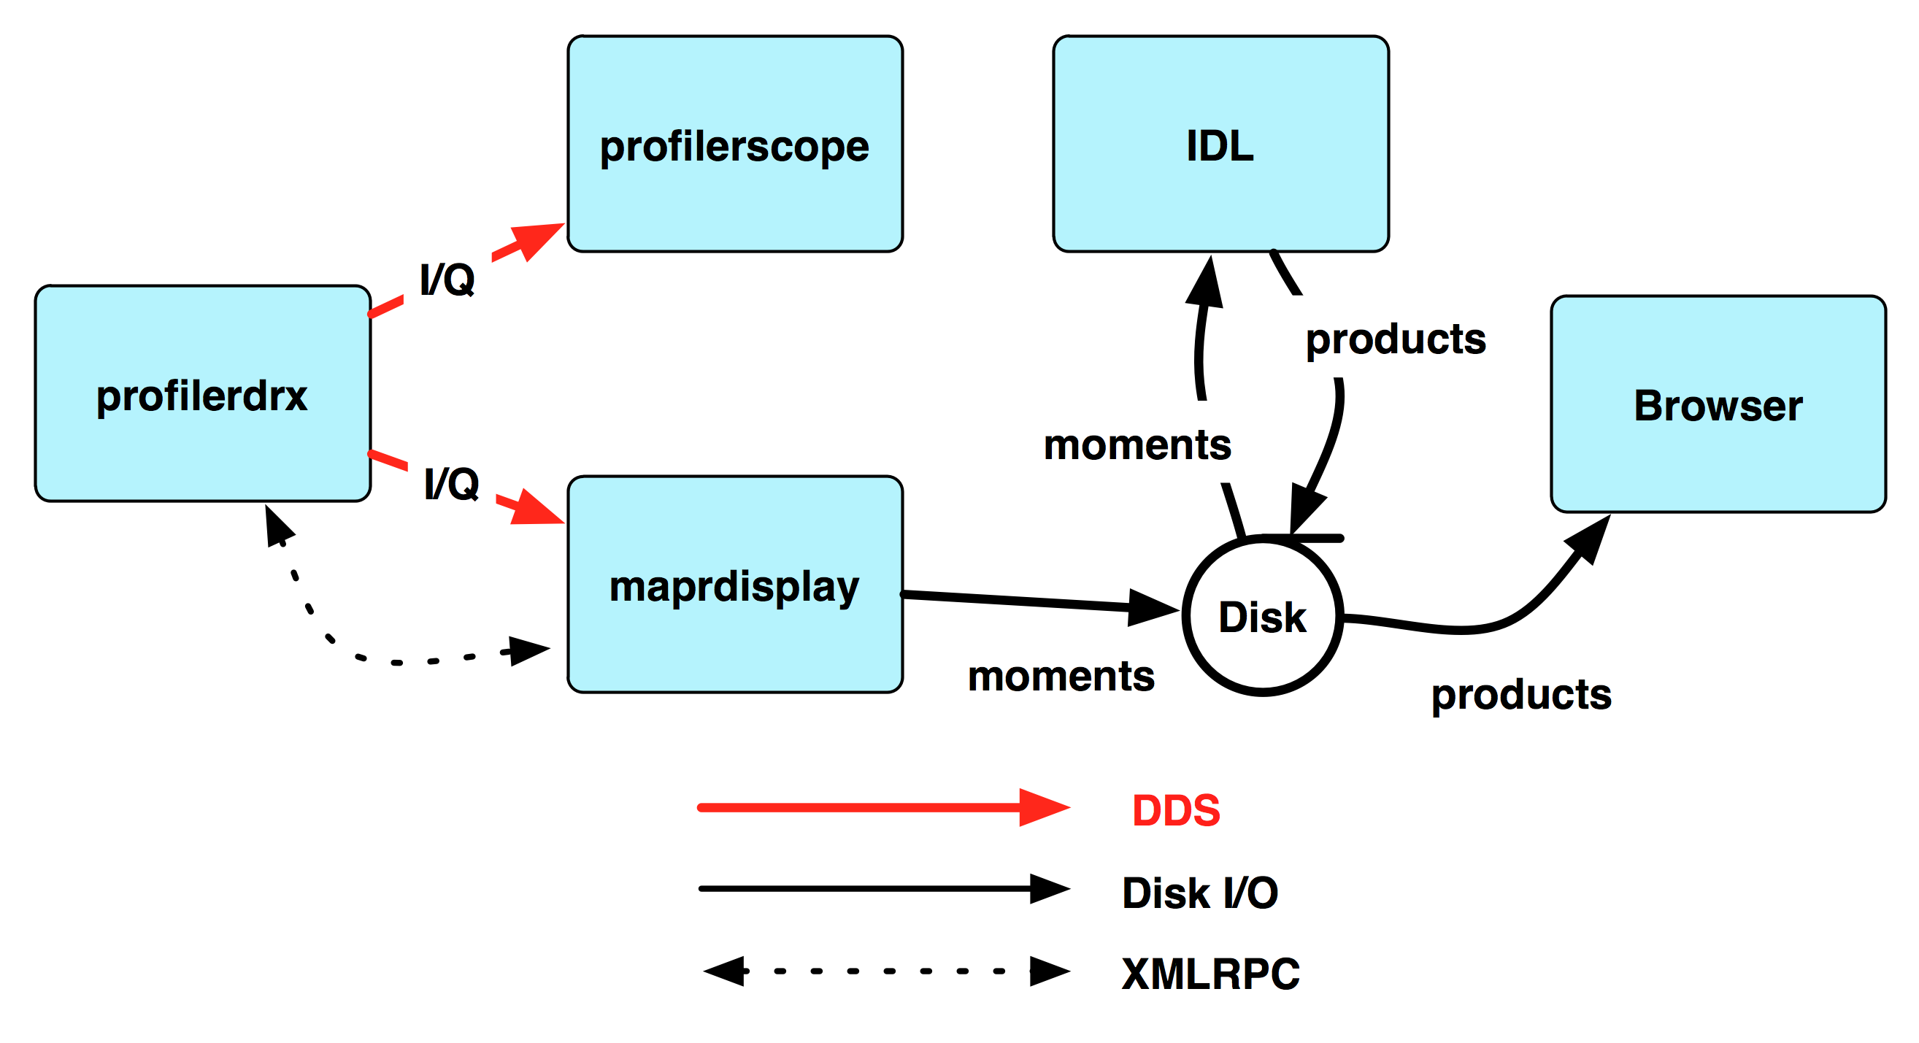
Profiler Processes

Slide 16
Profilerscope

Slide 17
Maprdisplay Processing
Computation
Display
Correlation functions
Power spectra
SNR estimates
NetCDF archiving
Stacked spectra
Stacked time series
SNR versus height
– Threaded --

Slide 18
Maprdisplay

Slide 19
Questions

